Slide 1

Model Based Segmentation in Regression Setting

Slide 2
MKT 591: Course Roadmap
Review of Quant Market Research
Prediction / Regression
Forecasting
Features & Dimensions
Market Segmentation
Simple Linear Regression
Demand Forecasting
Customer Classification
Factor Analysis
Segmentation General
Measurement Scales
Categorical Variables
BASS Diffusion Model
Discriminant Analysis
MDS
Model-based Segmentation in Regression
Discrete Analysis (CrossTab)
Extracting Features by Text Analytics
Multiple Regression
Bayesian Classifier
Spatial Analysis
Continuous Analysis (Correlation)
Issues in Regression
Tree Models
Deep Learning
Logistic Regression (Consumer Choice)
Bayesian Statistics

Slide 3
Latent Class Regression
Model Based Segmentation with Behavioral Variables (Regression Setting)
Some commercial software (e.g., Latent Gold)
Latent Class Mixture model (e.g., flexmix, mixtools) in R package
What are the cluster-wise key drivers on dependent variables (e.g., satisfaction)
Notes:
Class wise regression

Slide 4

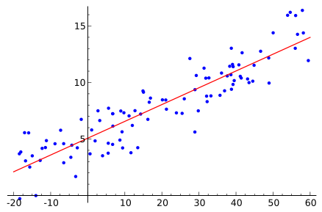
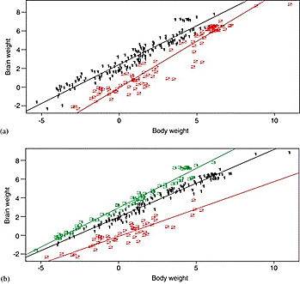
Illustrative Conversation between Director and Analytics
Bernie: Marketing Director of Allstate Insurance, Sunghoon: Data Analytics Manager
Bernie: How can we identify key drivers to improve customer service satisfaction?
Sunghoon: We can do a regression analysis to find out relationship between DV (satisfaction) and potential drivers (Attributes).
Bernie : But, do we assume that all customers are using same key drivers?
Sunghoon: We can find out multiple regression lines for different segments to identify different key drivers. We can do this by using latent class regression.

Slide 5
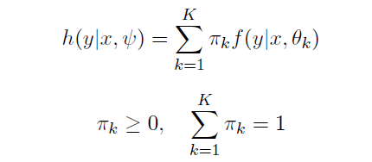
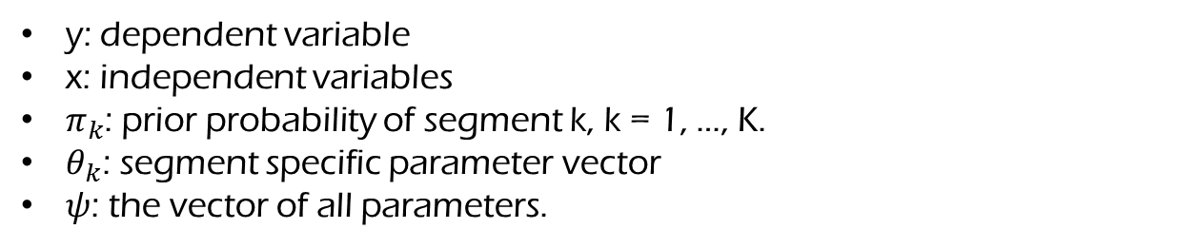
Latent Class Regression Model
Discrete Mixture: Latent Variable
y: dependent variable
x: independent variables
$π_{k}$: prior probability of segment k, k = 1, …, K.
$θ_{k}$: segment specific parameter vector
$ψ$: the vector of all parameters.
How to estimate this model? EM (Expectation-Maximization) Algorithm.

Slide 6
data for mixture regression setting…
Here, DV (Y) is buy intention for the product in the survey (N=200).
Impacts of IVs on DV in the data.
Key drivers for consumer in Segment 1
 | Segment 1 | Segment 2
Feature1 | 1 | 0
Feature2 | 1 | 0
Feature3 | 1 | 0
Feature4 | 1 | 0
Feature5 | 0 | 1.5
Feature6 | 0 | 1.5
Feature7 | 0 | 1.5
Feature8 | 0 | 1.5
Feature9 | 0 | 0
Feature10 | 0 | 0
Key drivers for consumer in Segment 2
53%
47%
Notes:
可以remove feature 9 和feature 10

Slide 7
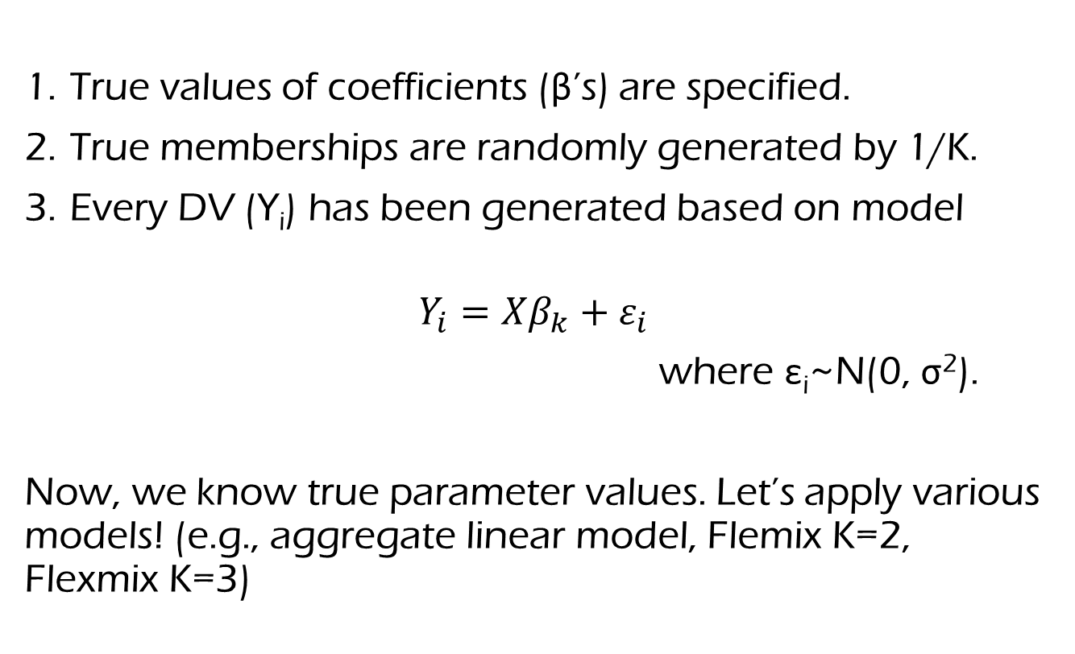
(Optional) Simulated Data Generation (If you are interested in…)
True values of coefficients (β’s) are specified.
True memberships are randomly generated by 1/K.
Every DV (Y_{i}) has been generated based on model
$$Y_{i}=Xβ_{k}+ε_{i}$$
where ε_{i}~N(0, σ²).
Now, we know true parameter values. Let’s apply various models! (e.g., aggregate linear model, Flemix K=2, Flexmix K=3)

Slide 8
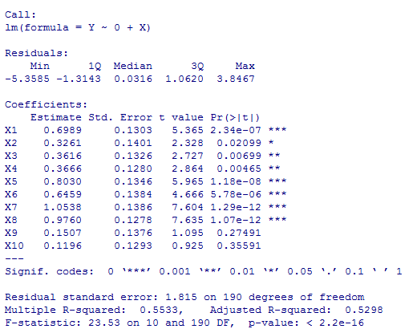
Let’s submit this data to aggregate linear regression first
Estimated results with simple regression
Can we know the segment-wise heterogeneity with the results?
Are the estimated results successfully identifying the segment-wise true drivers?

Slide 9
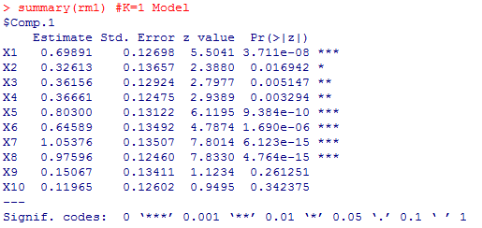
Estimated results with K=1 solution of Flexmix
As expected, the result is somewhat similar to the results by simple regression model.
BUT, the aggregate regression is limited to show segment-wise heterogeneity.
AIC: 1737, BIC: 1773

Slide 10
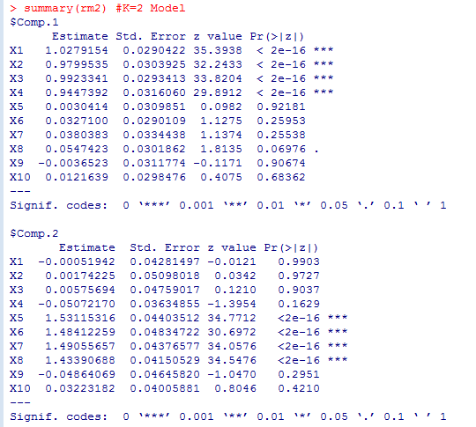
Two Segment (K=2) results by flexmix
AIC: 1316.8, BIC: 1392.6
Limitations and more (e.g., data application) will be discussed in the advanced segmentation method section.

Slide 11
Illustrative Conversation between Director and Analytics
Bernie: Marketing Director of Allstate Insurance, Sunghoon: Data Analytics Manager
Bernie: How can we identify key drivers to improve customer service satisfaction?
Sunghoon: We can do a regression analysis to find out relationship between DV (satisfaction) and potential drivers (Attributes).
Bernie : But, do we assume that all customers are using same key drivers?
Sunghoon: We can find out multiple regression lines for different segments to identify different key drivers. We can do this by using latent class regression.
Bernie : But, our typical service data has more than 20 or 30 predictors, and they can be highly correlated. As I heard, that method can be problematic with this type of data.
Sunghoon: Well… If so, we typically use variable selection in normal regression analysis. But, as far as I know, there is no method for simultaneously handling variable selection and latent class regression yet. Perhaps I should develop one!

Slide 12

Latent Class Regression
Amusement Park Satisfaction Data (see Text Book p160)
An amusement park collected survey from 500 customers and want to understand the relationship between various factors and customer satisfaction.
The data includes:
Distance (continuous): distance from home
Rides (continuous) # 100-point scale for satisfaction
Games (continuous) # 100-point scale for satisfaction
Wait (continuous) # 100-point scale for satisfaction
Clean (continuous) # 100-point scale for satisfaction
Overall (continuous) # 100-point scale for overall satisfaction (DV)
Try scale for IVs…

Slide 13

Segmentation Models with Stochastic Variable Selection in Marketing (Kim, Fong and DeSarbo 2012)
https://sites.google.com/a/asu.edu/skim348/home/model-codes

Slide 14





Segmentation with Stochastic Variable Selection
(Kim, Fong and DeSarbo 2012)
DV:
Satisfaction
Segment 1 (20%)
Problem Solving
Care
Modern-Looking
Problem Solving
Prompt Service
Care
Segment 2 (30%)
Safety
Simultaneously Selecting Key Drivers , Regression Analysis and Segmentation
Courtesy
Courtesy
Notes:
Let’s revisit to Bernie’s problem!

Slide 15
Behavioral Decision Theory in Marketing
Consumer Heterogeneity in feature utilization: Consumers may utilize or weight different attributes of brands to form their attitudes and choices.
Various factors from literature:
Different goals
E.g., Accuracy goals: more extensive processing of attribute information Vs. Effort minimization goals: fewer attributes. (Payne, Bettman, and Johnson 1993)
Prior knowledge
E.g., Experts recalls more attributes than novices and experts are more likely to focus on important and relevant attributes. (Alba and Hutchinson 1987, Vincente and Wang 1998)
Contextual factors
E.g., Under severe time pressure, consumers select a few important attributes and evaluate alternatives on the basis of this restricted set of dimensions (Payne, Bettman, and Luce 1996)
INTRODUCTION
MODEL DESCRIPTION
APPLICATION RESULT
DISCUSSION

Slide 16
Behavioral Decision Theory in Marketing
Various factors from literature (Cont’d):
Involvement
E.g., Highly involved decision makers tend to focus on relevant aspects of the choice task; Subjects with low involvement tend to focus on peripheral aspects (Petty and Cacioppo 1986).
Positive affect
E.g., Individuals in a positive mood are cognitively more flexible than those in negative or neutral moods, and they might utilize more attributes and broader dimensions during decision making (Isen 1993, Isen, Daubman and Nowicki 1987).
There can be substantial heterogeneity when different consumers derive their brand choices (or preferences) in terms of the different types of attribute information.
This type of heterogeneity becomes relevant when dealing with evaluations of brands with many features.
INTRODUCTION
MODEL DESCRIPTION
APPLICATION RESULT
DISCUSSION
Notes:
First model-based method is clusterwise regression procedures which are using Deterministic Least-Squares based methods.
Second model is more popular Latent structure regression.

Slide 17
Challenges: increasing number of features
Firms are currently adding more and more features into consumer products: E.g., smart phones, smart TV’s, automobiles, laptop computers, tablets etc.
This trend restricts the use of some traditional methods such as conjoint analysis where it is recommended not to utilize more than six or seven attributes or features (Green and Srinivasan 1978) to collect such preferences or choices.
Given a long list of attributes/features, consumers usually make their choice decisions only based on a subset of important attributes/features due to convenience, cost of thinking, or lack of expertise (Gilbride, Allenby, and Brazell 2006).
However, traditional choice methods assumed that consumers consider every attribute/feature for their choice.
INTRODUCTION
MODEL DESCRIPTION
APPLICATION RESULT
DISCUSSION
Notes:
First model-based method is clusterwise regression procedures which are using Deterministic Least-Squares based methods.
Second model is more popular Latent structure regression.

Slide 18
Previous Segmentation Models
Classical multivariate methods for segmentation
Cluster Analysis, discriminate analysis, regression analysis etc.
Recent model-based methods
Clusterwise regression procedures (e.g., Späth 1979, 1982; DeSarbo and Mahajan 1984; DeSarbo, Oliver and Rangaswamy 1989; Wedel and Steenkamp 1989, 1991)
Deterministic least-squares based methods.
Latent structure regression (e.g., DeSarbo and Cron 1988; Wedel and DeSarbo 1994)
Dependent variable is distributed as a finite mixture of a member of the exponential-family distributions (e.g., Normal, Poisson).
Software packages: Latent Gold, Flexmix.
Bayesian finite mixtures (e.g., Diebolt and Robert 1994; Lenk and DeSarbo 2000; Hurn, Justel, Robert 2003):
RegmixMH (From R package Mixtools)
Limitations???

Slide 19
Research Motivation
The Problem of Masking Variables
Including irrelevant independent variables can produce biased segmentation results (e.g., Brusco and Cradit 2001; DeSarbo et al. 1984; Fowlkes and Mallows 1983).
Limited Sample Sizes in Segmentation Models
Reduced sample size within each derived segment.
Retaining a full specification of IVs in each segment places heavy demand on degrees of freedom.
The Issue of Multicollinearity
Improper results about significance/effect of the Independent Variables.

Slide 20
Variable Selection
Variable Selection Approaches in high-dimensional data set for Traditional Multiple Regression
Bayesian variable selection (George and McCulloch 1993, 1997)
Penalized likelihood approach: Lasso or SCAD (Tibshirani 1996, Fan and Li 2001)
Recent Clustering Methods with Variable Selection
Bayesian variable selection model in clustering finds discriminating variables among vast number of variables with small sample size (e.g., Tadesse, Sha and Vannucci 2005; Kim, Tadesse and Vannucci 2006)
These methods have been developed in an unsupervised setting and don’t solve heterogeneity problem in variable selection.
Penalized likelihood approach for latent structure regression (e.g., Khalili and Chen 2007)
User must arbitrarily set tuning parameter values which can dramatically affect segmentation and variable selection results.
K&C (2007) has software limitation: (1) only available for K=2 (2) no membership information (3) three-step procedure for bootstrapping

Slide 21
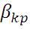
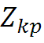
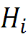
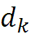
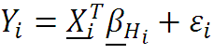
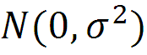
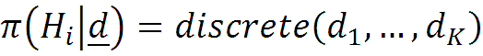
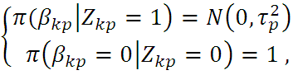
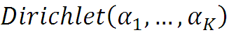
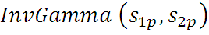
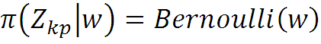
The Hierarchical Structure of Unconstrained Model Assumptions
Notation: (“k” for segments; “p” for independent variables, “i” for individuals)
: Segment level regression coefficient, (k=1,…K, p=1,…,P), : Variable selection indicator,
: Segment Index Variable (H_{i}=1,…, K),
, : Parameters of each discrete and Bernoulli distribution , : Variance of
$$π\left(σ^{2}\right)=InvGamma \left(s_{1},s_{2}\right)$$
$$π\left(w\right)=Beta(t_{1},t_{2})$$

Slide 22
So many correlated IVs and Overfitting Issue? Again, let’s apply the proposed Clusterwise regression with Variable Selection (R example)
Here, DV (Y) is buy intention for the product in the survey.
Assumed True Coefficients on DV in the simulated data.
Key drivers for consumer in Segment 1
 | Segment 1 | Segment 2 | Segment 3
Feature 1 | 0 | 0 | 2
Feature 2 | 0 | 0 | 2
Feature 3 | 0 | 0 | 2
Feature 4 | 0 | 0 | 2
Feature 5 | 0 | 1.5 | 0
Feature 6 | 0 | 1.5 | 0
Feature 7 | 0 | 1.5 | 0
Feature 8 | 0 | 1.5 | 0
Feature 9 | 1.7 | 0 | 0
Feature 10 | 1.7 | 0 | 0
Feature 11 | 1.7 | 0 | 0
Feature 12 | 1.7 | 0 | 0
Feature 13 | 1.7 | 0 | 0
Feature 14 | 1.7 | 0 | 0
Feature 15 | 0 | 0 | 0
Feature 16 | 0 | 0 | 0
Feature 17 | 0 | 0 | 0
Feature 18 | 0 | 0 | 0
Feature 19 | 0 | 0 | 0
Feature 20 | 0 | 0 | 0
Key drivers for consumer in Segment 3
More number of Features but smaller sample size (N=180)!
Key drivers for consumer in Segment 2
32% 37% 31%

Slide 23


Segmentation Model with Constrained Variable Selection (Kim, Blanchard, DeSarbo and Fong 2013)
DV:
Satisfaction
Segment 1
Attribute 3
Attribute 1
Segmentation
Attribute 15
Regression
Attribute 2
Attribute 3
Variable Selection
Managerial Constraints
Attribute 2
Segment 2
Attribute 11
Simultaneously Selecting Constrained Key Drivers , Regression Analysis & Clustering
+ Common Factors, Distinctive Factors and Dimension Constrained Factors
Attribute 20
Attribute 30

Slide 24
Unconstrained Model
Dimension | Variables | Coefficients
 | Segment | Segment 1
Intercept | Intercept | 0.5*
Reliability | Reliability1 | 0
 | Reliability2 | 0
 | Reliability3 | 0
 | Reliability4 | 0.5*
 | Reliability5 | 0
Empathy | Empathy1 | 0
 | Empathy2 | 0
 | Empathy3 | 0
 | Empathy4 | 0
 | Empathy5 | 0
Tangibles | Tangibles1 | 0
 | Tangibles2 | 0
 | Tangibles3 | 0.7*
 | Tangibles4 | 0
Responsiveness | Responsiveness1 | 0
 | Responsiveness2 | 0
 | Responsiveness3 | 0
 | Responsiveness4 | 1*
Assurance | Assurance1 | 0
 | Assurance2 | 0
 | Assurance3 | 0
 | Assurance4 | 0
Coefficients
Segment 2
1*
0
0
0
0
0
0
0
0
0.3*
0
0
0
0
0
0
0
0
1.5*
0
0
0
0
Z_{kp}=1
Z_{kp}=0
Z_{kp} indicates if the p^{th} coefficient of k^{th} segment can be selected or not.
INTRODUCTION
FOUR MODELS
RESULTS
DISCUSSION

Slide 25
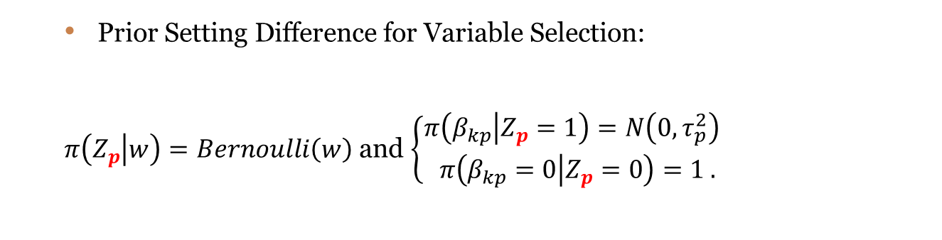
Common Factors Model
All derived segments utilize the same drivers of service quality, but to different extents.
A firm can launch small marketing campaigns given limited marketing resources while allowing for restricted heterogeneity of consumers.
E.g., When a regional insurance firm attempts to launch a number of small marketing campaigns (e.g., Auto, Home, and Life) with limited resources, the firm may want to identify a common set of key drivers but emphasize them to different extents.
Prior Setting Difference for Variable Selection:
$π\left(Z_{p} | w\right)=Bernoulli\left(w\right)$ and $\left\{\begin{aligned}π\left(β_{kp} | Z_{p}=1\right)=N\left(0, τ_{p}^{2}\right) \\ π\left(β_{kp}=0 | Z_{p}=0\right)=1 .\end{aligned}\right.$
INTRODUCTION
FOUR MODELS
RESULTS
DISCUSSION

Slide 26
Common Factors Model
Dimension | Variables | Coefficients
 | Segment | Segment 1
Intercept | Intercept | 0.5*
Reliability | Reliability1 | 0
 | Reliability2 | 0
 | Reliability3 | 0
 | Reliability4 | 0.5*
 | Reliability5 | 0
Empathy | Empathy1 | 0
 | Empathy2 | 0
 | Empathy3 | 0
 | Empathy4 | 0
 | Empathy5 | 0
Tangibles | Tangibles1 | 0
 | Tangibles2 | 0
 | Tangibles3 | 0
 | Tangibles4 | 0
Responsiveness | Responsiveness1 | 0
 | Responsiveness2 | 0
 | Responsiveness3 | 0
 | Responsiveness4 | 1*
Assurance | Assurance1 | 0
 | Assurance2 | 0
 | Assurance3 | 0
 | Assurance4 | 0
Coefficients
Segment 2
1*
0
0
0
1.2*
0
0
0
0
0
0
0
0
0
0
0
0
0
1.5*
0
0
0
0
Z_{p}=1
Z_{p}=0
Z_{p} indicates if the p^{th} vector of coefficients across segments can be selected or not.
INTRODUCTION
FOUR MODELS
RESULTS
DISCUSSION

Slide 27

Distinctive Factors Model
Each derived market segment utilizes different drivers of service quality.
Practical importance that the identified segments respond entirely differently to alternative marketing mixes (Wedel and Kamakura, 2000).
E.g., Allstate insurance may wish to employ such constraints to ensure distinctive service positioning to minimize cannibalization between two brands.
INTRODUCTION
FOUR MODELS
RESULTS
DISCUSSION
Notes:
We can think of practical importance that the identified segments respond entirely differently to alternative marketing mixes.

Slide 28
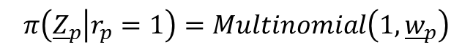
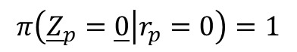
Distinctive Factors Model
Dimension | Variables | Coefficients
 | Segment | Segment 1
Intercept | Intercept | 0.5*
Reliability | Reliability1 | 0
 | Reliability2 | 0
 | Reliability3 | 0
 | Reliability4 | 0.5*
 | Reliability5 | 0
Empathy | Empathy1 | 0
 | Empathy2 | 0
 | Empathy3 | 1.6*
 | Empathy4 | 0
 | Empathy5 | 0
Tangibles | Tangibles1 | 0
 | Tangibles2 | 0
 | Tangibles3 | 0
 | Tangibles4 | 0
Responsiveness | Responsiveness1 | 0
 | Responsiveness2 | 0
 | Responsiveness3 | 0
 | Responsiveness4 | 1*
Assurance | Assurance1 | 0
 | Assurance2 | 0
 | Assurance3 | 0
 | Assurance4 | 0
Coefficients
Segment 2
1*
0
0
0.7*
0
0
0
0
0
0
0
0
0
0
1.1*
0
0
0
0
0
0
0
0
r_{p}=1
Multinomial (1, w_{p})
$$π\left({\underline{Z}}_{p} | r_{p}=1\right)=Multinomial\left(1, {\underline{w}}_{p}\right)$$
r_{p}=0
$$π\left({\underline{Z}}_{p}=\underline{0} | r_{p}=0\right)=1$$
r_{p} indicates if the p^{th} vector of coefficients across segments can be selected or not.
When r_{p}=1, only one key variable can be selected based on probability w.
INTRODUCTION
FOUR MODELS
RESULTS
DISCUSSION

Slide 29
Dimension Constrained Model
Select (at most) one priority item from any dimension for each derived segment.
Managers may want to have better understanding of investment priority from each dimension at any given point in time.
It is difficult to both modernize the equipment (item #1) and improve the general look of the facilities (item #2) in the Tangibility dimension.
INTRODUCTION
FOUR MODELS
RESULTS
DISCUSSION

Slide 30
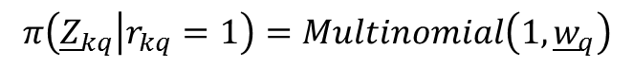
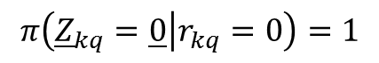
Dimension Constrained Model
Dimension | Variables | Coefficients
 | Segment | Segment 1
Intercept | Intercept | 0.5*
Reliability | Reliability1 | 0
 | Reliability2 | 0
 | Reliability3 | 0
 | Reliability4 | 0.5*
 | Reliability5 | 0
Empathy | Empathy1 | 0
 | Empathy2 | 0
 | Empathy3 | 0
 | Empathy4 | 0
 | Empathy5 | 0
Tangibles | Tangibles1 | 0
 | Tangibles2 | 0
 | Tangibles3 | 0.7*
 | Tangibles4 | 0
Responsiveness | Responsiveness1 | 0
 | Responsiveness2 | 0
 | Responsiveness3 | 0
 | Responsiveness4 | 1*
Assurance | Assurance1 | 0
 | Assurance2 | 0
 | Assurance3 | 0
 | Assurance4 | 0
Coefficients
Segment 2
1*
0
0
0
0
0
0
0
0
0.3*
0
0
0
0
0
0
0
0
1.5*
0
0
0
0
$$π\left({\underline{Z}}_{kq} | r_{kq}=1\right)=Multinomial\left(1, {\underline{w}}_{q}\right)$$
r_{kq}=1
Multinomial (1, w_{q})
r_{kq}=0
$$π\left({\underline{Z}}_{kq}=\underline{0} | r_{kq}=0\right)=1$$
r_{kq} indicates if the q^{th} vector of coefficients in k^{th} segment can be selected or not.
When r_{kq} =1, only one key variable can be selected based on probability w.
INTRODUCTION
FOUR MODELS
RESULTS
DISCUSSION

Slide 31
Model Operation
Developed Efficient MCMC Algorithms for the Four Proposed Models.
Gibbs Sampler for posterior inference.
Relabeling Algorithm
Preventing possible label-switching issue.
Relabeling associated parameters based on the constraint of ordering segment coefficients (β_{1p}< β_{2p}< ··· < β_{Kp}):
Model Selection: Log Marginal Likelihood Comparison
Marginal likelihood identity by Chib (1995):
Variable Selection Criteria: Odds Ratio
Odds ratio 20 is used for selection criteria.
INTRODUCTION
FOUR MODELS
RESULTS
DISCUSSION

Slide 32

SERVPERF Application
SERVPERF (Cronin and Taylor 1992) Survey from National Insurance Company
SERVPERF data from a questionnaire mailed to a random sample of 1000 policyholders at the National Insurance Company which we obtained from Parasuraman, Grewal, and Krishnan (1991).
Here measured with 22 items of 5 dimensions in single item format (just performance).
INTRODUCTION
FOUR MODELS
RESULTS
DISCUSSION

Slide 33
Challenges of SERVPERF Application
Finding Key Drivers for Improving Service Quality.
Substantial Heterogeneity: Important to Identify Heterogeneous Key Drivers.
Difficulty with SERVPERF Data: High Correlations among Multiple Items.
Limited Sample Size (Mailed Random 1000 Samples but Only 191 Completes).
INTRODUCTION
FOUR MODELS
RESULTS
DISCUSSION

Slide 34
Correlation Matrix
 | Q02 | Q03 | Q04 | Q05 | Q06 | Q07 | Q08 | Q09 | Q10 | Q11 | Q12 | Q13 | Q14 | Q15 | Q16 | Q17 | Q18 | Q19 | Q20 | Q21 | Q22 | Service Quality
Q01 | .76 | .75 | .82 | .21 | .67 | .27 | .46 | .38 | .58 | .24 | .28 | .35 | .32 | .59 | .60 | .60 | .61 | .59 | .71 | .45 | .58 | .78
Q02 |  | .73 | .74 | .32 | .81 | .40 | .66 | .46 | .70 | .30 | .34 | .52 | .39 | .70 | .74 | .79 | .74 | .76 | .76 | .67 | .66 | .84
Q03 |  |  | .76 | .25 | .66 | .30 | .50 | .39 | .61 | .25 | .31 | .43 | .37 | .67 | .63 | .59 | .58 | .64 | .70 | .53 | .62 | .78
Q04 |  |  |  | .28 | .75 | .31 | .55 | .33 | .63 | .28 | .31 | .43 | .35 | .69 | .70 | .66 | .64 | .66 | .73 | .61 | .65 | .80
Q05 |  |  |  |  | .34 | .13 | .33 | .28 | .27 | .14 | .21 | .28 | .14 | .30 | .32 | .27 | .29 | .36 | .29 | .35 | .35 | .26
Q06 |  |  |  |  |  | .42 | .69 | .37 | .70 | .29 | .29 | .55 | .43 | .69 | .72 | .71 | .70 | .70 | .72 | .63 | .66 | .82
Q07 |  |  |  |  |  |  | .41 | .16 | .47 | .46 | .44 | .31 | .50 | .41 | .38 | .39 | .45 | .39 | .35 | .35 | .36 | .44
Q08 |  |  |  |  |  |  |  | .33 | .70 | .31 | .34 | .70 | .41 | .74 | .82 | .74 | .77 | .76 | .57 | .73 | .71 | .65
Q09 |  |  |  |  |  |  |  |  | .42 | .02 | .07 | .20 | .10 | .38 | .38 | .42 | .40 | .46 | .46 | .28 | .34 | .46
Q10 |  |  |  |  |  |  |  |  |  | .35 | .37 | .51 | .46 | .76 | .76 | .78 | .78 | .79 | .72 | .66 | .69 | .77
Q11 |  |  |  |  |  |  |  |  |  |  | .89 | .40 | .78 | .34 | .30 | .30 | .28 | .27 | .23 | .28 | .23 | .28
Q12 |  |  |  |  |  |  |  |  |  |  |  | .37 | .74 | .39 | .35 | .31 | .31 | .30 | .26 | .34 | .29 | .30
Q13 |  |  |  |  |  |  |  |  |  |  |  |  | .50 | .64 | .64 | .60 | .56 | .57 | .44 | .75 | .60 | .52
Q14 |  |  |  |  |  |  |  |  |  |  |  |  |  | .43 | .40 | .39 | .40 | .35 | .32 | .39 | .34 | .42
Q15 |  |  |  |  |  |  |  |  |  |  |  |  |  |  | .85 | .79 | .77 | .77 | .70 | .75 | .77 | .76
Q16 |  |  |  |  |  |  |  |  |  |  |  |  |  |  |  | .83 | .83 | .80 | .70 | .76 | .78 | .76
Q17 |  |  |  |  |  |  |  |  |  |  |  |  |  |  |  |  | .88 | .87 | .78 | .77 | .76 | .80
Q18 |  |  |  |  |  |  |  |  |  |  |  |  |  |  |  |  |  | .86 | .76 | .73 | .77 | .79
Q19 |  |  |  |  |  |  |  |  |  |  |  |  |  |  |  |  |  |  | .81 | .75 | .76 | .81
Q20 |  |  |  |  |  |  |  |  |  |  |  |  |  |  |  |  |  |  |  | .63 | .74 | .88
Q21 |  |  |  |  |  |  |  |  |  |  |  |  |  |  |  |  |  |  |  |  | .78 | .66
Q22 |  |  |  |  |  |  |  |  |  |  |  |  |  |  |  |  |  |  |  |  |  | .76
Note: Shaded cells denotes correlations significant at p<.05
Note: All correlations are positive!
INTRODUCTION
FOUR MODELS
RESULTS
DISCUSSION

Slide 35
Dimensions | IVs | OLS Regression | Stepwise Regression
 | Intercept | -0.93 | -1.05
Reliability | Reliability 1 | 0.14 | 0.21
 | Reliability 2 | 0.16 | 0
 | Reliability 3 | 0.17 | 0.25
 | Reliability 4 | 0.11 | 0
 | Reliability 5 | -0.1 | 0
Empathy | Empathy 1 | 0.23 | 0.32
 | Empathy 2 | 0.08 | 0.1
 | Empathy 3 | -0.03 | 0
 | Empathy 4 | 0.06 | 0
 | Empathy 5 | 0.08 | 0
Tangibles | Tangibles 1 | -0.01 | 0
 | Tangibles 2 | -0.12 | 0
 | Tangibles 3 | 0.06 | 0
 | Tangibles 4 | 0.12 | 0
Responsiveness | Responsiveness 1 | 0.07 | 0
 | Responsiveness 2 | -0.09 | 0
 | Responsiveness 3 | 0.03 | 0
 | Responsiveness 4 | 0.07 | 0.2
Assurance | Assurance 1 | 0.1 | 0
 | Assurance 2 | 0.42 | 0.53
 | Assurance 3 | -0.12 | 0
 | Assurance 4 | 0.17 | 0
Measure of (Multi)collinearity |  | Condition Index: 71.4 | Condition Index: 19.6
Traditional Methods
OLS Regression:
One Negative Coefficient
Condition Index: 71.4
Stepwise Regression:
Condition Index: 19.6
How about Heterogeneity?
Note1) Shaded cells denote significant coefficients at p<.05
Note 2) For Condition Index, 30 or lower can be used for rule of thumb.
INTRODUCTION
FOUR MODELS
RESULTS
DISCUSSION

Slide 36
Traditional Latent Class Solutions
 | K=1 | K=2 | K=3 | K=4 | K=5
AIC | 489.28 | 433.33 | 333.38 | 225.74 | 133.97
AIC3 | 513.28 | 482.33 | 407.38 | 324.74 | 257.97
BIC | 567.33 | 592.7 | 574.05 | 547.72 | 537.25
CAIC | 591.33 | 641.7 | 648.05 | 646.72 | 661.25
Dimensions | IVs | FLEXMIX (K=5) |  |  |  |  | RegmixMH
 |  | k=1 | k=2 | k=3 | k=4 | k=5 | k=1 | k=2
 | Intercept | 0.29 | -1.4 | 1.66 | -2.28 | -1.29 | 0.62 | 2
Reliability | Reliability 1 | 0.27 | -0.04 | -0.1 | -0.52 | 0.5 | 2.44 | 1.75
 | Reliability 2 | 0.2 | 0.29 | 0.11 | 0.51 | -0.15 | 2 | 2.45
 | Reliability 3 | 0.42 | 0.13 | 0.48 | 0.28 | -0.08 | 0.4 | -0.62
 | Reliability 4 | 0.05 | 0.07 | 0.28 | 1.01 | -0.29 | -0.12 | 0.33
 | Reliability 5 | -0.15 | -0.12 | 0.07 | -0.08 | -0.07 | 0.76 | 0.01
Empathy | Empathy 1 | 0.4 | 0.13 | 0.24 | 0.2 | 0.16 | 2.12 | 0.22
 | Empathy 2 | -0.24 | 0.13 | 0.11 | 0.13 | 0.01 | 0.34 | -0.06
 | Empathy 3 | 0.26 | -0.25 | 0.07 | -0.36 | 0.08 | -0.09 | -0.16
 | Empathy 4 | -0.22 | 0.14 | 0.15 | 0.05 | 0.15 | 2.3 | 0.17
 | Empathy 5 | 0.29 | 0.22 | -0.44 | 0.37 | 0 | 2.17 | 0.13
Tangibles | Tangibles 1 | 0.11 | -0.44 | 0.7 | -0.29 | 0.19 | 3.82 | 0.01
 | Tangibles 2 | 0.15 | 0.26 | -0.93 | -0.08 | -0.4 | 0.93 | 0
 | Tangibles 3 | -0.09 | 0.2 | -0.21 | 0.27 | -0.08 | 0.66 | 0.19
 | Tangibles 4 | -0.24 | 0.43 | 0 | 0.52 | 0.36 | 1.56 | -1.07
Responsiveness | Responsiveness 1 | -0.56 | 0.19 | -0.27 | 0 | 0.28 | 0.31 | 0.63
 | Responsiveness 2 | -0.21 | 0.01 | 0.59 | -0.7 | 0.07 | -1.16 | 0.15
 | Responsiveness 3 | 0.17 | -0.2 | -0.05 | -0.38 | -0.09 | 0.9 | 0.43
 | Responsiveness 4 | 0.07 | 0.01 | 0.24 | 0.41 | 0.09 | -0.9 | -0.07
Assurance | Assurance 1 | 0 | 0.24 | -0.13 | 0.23 | -0.15 | 1.19 | 0.02
 | Assurance 2 | 0.51 | 0.41 | 0.23 | -0.12 | 0.96 | 2 | -0.07
 | Assurance 3 | -0.41 | -0.44 | -0.19 | 0.07 | 0.2 | 1.75 | 0.01
 | Assurance 4 | 0.46 | 0.39 | 0.37 | 0.23 | -0.05 | 2.45 | 0.19
 | Mixture | 24% | 17% | 21% | 19% | 20% | 2% | 98%
Notes:
Intercept is expected mean value of Y when all X=0. If never all X=0, Intercept can be only meaningful for prediction purpose. But, X is centralized, Intercept itself (Not even when all X=0) is expected mean of Y. Meaning here is to understand the relationship between predictors and the response.

Slide 37
The Proposed Models: Model Selection
Log Marginal Likelihood | K=1 | K=2 | K=3 | K=4 | K=5
Unconstrained Model | -202.8 | -179.4 | -307.0 | -401.6 | -588.3
Common Factors Model | -244.3 | -315.2 | -342.2 | -389.7 | -401.3
Dimension Constrained | -282.9 | -312.5 | -411.8 | -453.3 | -487.7
Distinctive Factors Model | -226.8 | -145.6 | -263.0 | -357.9 | -600.1
K=2 of the Distinctive Factors Model has been selected (Note: Select higher LML value).
INTRODUCTION
FOUR MODELS
RESULTS
DISCUSSION

Slide 38
SOLUTIONS FOR THE PROPOSED MODELS
 |  | Distinctive Factors Model (K=2)
 |  | k=1 | k=2
Intercept | Intercept | -0.25 | -0.03
Reliability | Reliability1 | 0 | 0.27
 | Reliability2 | 0.33 | 0
 | Reliability3 | 0 | 0
 | Reliability4 | 0 | 0
 | Reliability5 | 0 | 0
Empathy | Empathy1 | 0 | 0.22
 | Empathy2 | 0 | 0
 | Empathy3 | 0 | 0
 | Empathy4 | 0 | 0
 | Empathy5 | 0.56 | 0
Tangibles | Tangibles1 | 0 | 0
 | Tangibles2 | 0 | 0
 | Tangibles3 | 0 | 0
 | Tangibles4 | 0 | 0
Responsiveness | Responsiveness1 | 0 | 0
 | Responsiveness2 | 0 | 0
 | Responsiveness3 | 0 | 0
 | Responsiveness4 | 0 | 0
Assurance | Assurance1 | 0 | 0
 | Assurance2 | 0 | 0.52
 | Assurance3 | 0 | 0
 | Assurance4 | 0 | 0
Mixture |  | 14% | 86%
Compared with problematic traditional solutions: (1) two or three positive coefficients are selected across derived segments, and
(2) seizable proportion of mixture.
INTRODUCTION
FOUR MODELS
RESULTS
DISCUSSION

Slide 39
Possible Managerial Implications Based on Profile Analysis
Managerial Implications: At the early stage of relationship, National should try more efforts to understand their needs (Empathy 5) and to solve their problems with a sincere interest (Reliability 2).
A small segment of overall less satisfied users with a potential for higher loyalty with improved early retention strategies – Had more problems with National.
“Diamond in the Rough” Segment (14%)
Reliability 2 and Empathy 5
“Bread and Butter” Segment (86%)
Reliability 1, Empathy 1 and Assurance 2
A major segment of more satisfied users whom National needs efficient retention marketing strategies.
Managerial Implications: To efficiently maintain this large group of users, the firm should keep doing communications that National does care customers (Empathy 1) and customers will be safe with National (Assurance 2). Additionally, it is important to provide impression that National keep promises (Reliability 1).
INTRODUCTION
FOUR MODELS
RESULTS
DISCUSSION
Notes:
Don’t explain too much here. Seg 1 is less satisfied but more potential for long-term profitable customer group. So at the early state of relation ship, National should care this group with selected variables. Done!

Slide 40
Result Summary
The proposed Bayesian model simultaneously provides solutions for heterogeneity and important drivers per derived segment. http://www.personal.psu.edu/suk220/SegVS.html
From Monte Carlo Analysis, it is crucial to use the proper model to correctly capture the underlying data structure and the Bayes models provides robustness against (multi)collinearity over traditional methods.
In the application study, the Distinctive Factors solution provided most meaningful and interpretable results in the context of a national insurance company’s SERVPERF survey instrument.
INTRODUCTION
FOUR MODELS
RESULTS
DISCUSSION

Slide 41

An Integrated Bayesian Approach for Simultaneous Multivariate Probit Regression, Variable Selection, and Market Segmentation (Kim et al. 2018)

Slide 42
New Challenges in this Segmentation Modeling
(Kim, DeSarbo and Fong 2018)
Choice Consideration 1 (Yes or No)
Choice Consideration 2 (Yes or No)
Choice Consideration 3 (Yes or No)
Choice Consideration M (Yes or No)
Correlated Structure of Multiple Binary Choices
Feature 1
Feature 2
Feature 3
Subset of Key Drivers out of Many Features
Feature P
Notes:
Let’s revisit to Bernie’s problem!

Slide 43
The Proposed Segmentation Model for New Challenges
Correlated Choices: Multivariate Probit model for estimating correlation matrices
Segmentation:
allocating individuals to each segment
Key Feature Selection: Stochastic Variable Selection

Slide 44


Visualization of the Key Mechanism
Dependence Structure
DV:
...
DV:
Choice 2
DV:
Choice M
DV:
Choice 1
Feature 1
Segment 1 (30%)
Feature 3
IV: Feature 1
Correlation Matrix 1
IV: Feature 2
IV: Feature 3
Feature 2
Segment 2 (40%)
Feature 3
Simultaneously Selecting Key Drivers , Multivariate Probit Analysis and Segmentation
Correlation Matrix 2
IV: Feature P
Notes:
Let’s revisit to Bernie’s problem!

Slide 45
Dilemma in Choice Modeling
The number of choice alternatives (M) cannot be very large before the consumer becomes overwhelmed.
From a modeling perspective, very large M can produce computational difficulties in deriving estimates of covariance matrix in the multivariate probit model.
When M is relatively small and P (number of features) gets very large, each (individual level) model can suffer from the “high dimension, low sample-size” paradigm.
Thus, we need to handle the relatively small M and increasing number of P in the modern marketing environment.
INTRODUCTION
MODEL DESCRIPTION
APPLICATION RESULT
DISCUSSION

Slide 46
Summary of Research Motivations
Removing irrelevant independent variables
Including irrelevant independent variables can produce biased segmentation results (e.g., Brusco and Cradit 2001; DeSarbo et al. 1984; Kim, Fong and DeSarbo 2012).
Large P and relatively small M (Choices alternative) issue
Retaining a full specification of IVs in each segment places heavy demand on degrees of freedom.
Much severe for individual level choice model but it can be an issue for segment level model as well.
Reflecting dependence structure between multiple choices
Estimating covariance matrices in multivariate probit mixture model.
The Issue of Multicollinearity between Variables
Improper results about significance/effect of the IVs.
INTRODUCTION
MODEL DESCRIPTION
APPLICATION RESULT
DISCUSSION
Notes:
New marketing environment – too many features
Why not dimension reduction problem?

Slide 47
The Proposed Model
Correlated choices: multivariate Probit model for estimating correlation matrices
Segmentation:
allocating individuals to each estimated segment
Key Feature selection: Stochastic Variable Selection
INTRODUCTION
MODEL DESCRIPTION
APPLICATION RESULT
DISCUSSION
Notes:
In this research, I will extend the unconstrained model by Kim, Fong and DeSarbo.
But, this unconstrained model has extension motivations because of lack of managerial actionability. Variable selection should be more actionable or implementable by enforcing “appropriate managerial constraints”.

Slide 48
Stochastic Variable Selection Procedure
Variables | Coefficients
Segment | Segment 1
Intercept | 0.5*
Feature1 | 0
Feature2 | 0
Feature3 | 0
Feature4 | 0.5*
Feature5 | 0
Feature6 | 0
Feature7 | 0
Feature8 | 0
Feature9 | 0
Feature10 | 0
Feature11 | 0
Feature12 | 0
Feature13 | 0.7*
Feature14 | 0
Feature15 | 0
Feature16 | 0
Feature17 | 0
Feature18 | 1*
Feature19 | 0
Feature20 | 0
Feature21 | 0
Feature22 | 0
Coefficients
Segment 2
1*
0
0
0
0
0
0
0
0
0.3*
0
0
0
0
0
0
0
0
1.5*
0
0
0
0
Z_{kp}=1
Z_{kp}=0
Z_{kp} indicates if the p^{th} coefficient of k^{th} segment can be selected or not.
INTRODUCTION
MODEL DESCRIPTION
APPLICATION RESULT
DISCUSSION
Notes:
This slide provides more intuitive pictorial understanding of unconstrained variable selection.

Slide 49
Large Sports Utility Vehicles Application
A tracking study to gauge automotive marketing choice consideration behavior by a Large US automotive consumer research supplier.
Collected from consumer panel of more than 600,000 nationally representative households.
This Brand Image Study had been conducted among new vehicle intenders semiannually in June and December for the past 20 years.
The ending sample for this study is 290 consumer intenders for large sport utility segment.
The respondents rated how likely they consider purchasing 16 SUV brands and they used a five-point interval scale to rate each vehicle on 24 attributes.
INTRODUCTION
MODEL DESCRIPTION
APPLICATION RESULT
DISCUSSION

Slide 50
Attributes | Large SUV Brands
foreign (Foreign Brands), gasmile (Excellent Gas Mileage), value4money (Good Value for the Money), workmanship (Excellent Workmanship), ride-handling (Good Ride/Handling – Streets & Highways), load-unload (Easy to Load & Unload), lurxurious (Luxurious), safety (Good Safety/Protection for Occupants), ride-offroad (Good Ride & Handling Off-Road), rugged (Built Rugged and Tough), towing (Excellent Towing Capability), price (Reasonably Priced), sporty (Sporty), good-looking (Good Looking), family-use (Good Vehicle for Family Use), fun2drive (Fun to Drive), passenger room (Good Interior Passenger Room), enter-exit (Easy to Enter/Exit), dependable (Dependable), acceleration (Excellent Acceleration), cargo space (Excellent Cargo Space), prestigious (Prestigious), tech-adv (Technically Advanced), trade-in (High Trade-in Value). | Chevy Suburban, Chevy Tahoe, Ford Expedition, Range Rover, Toyota Land Cruiser, Yukon Denali, Ford Excursion, Lincoln Navigator, Lexus LX470, Toyota Sequoia, Hummer H1, Escalade EXT, GMC Yukon, Mercedes G Class, Hummer H2, Escalade ESV.

Slide 51
Three Traditional Methods
 | Logistic Regression | Stepwise Logistic Regression | Bayesian Multivariate Probit (Rossi 2013)
intercept | -5.09 | -5.04 | -9.29
foreign | -0.82 | -0.83 | -0.78
gasmile | -0.04 | 0 | -0.04
value4money | 0.18 | 0.2 | 0.22
workmanship | 0.05 | 0 | 0.06
ride-handling | 0.04 | 0 | 0.04
load-unload | 0.06 | 0.08 | 0.11
lurxurious | 0 | 0 | 0.07
safety | -0.1 | -0.07 | -0.1
ride-offroad | -0.05 | -0.05 | -0.05
rugged | 0.02 | 0 | 0.07
towing | 0.05 | 0.07 | 0.12
price | 0.05 | 0 | 0.08
sporty | -0.03 | 0 | -0.01
good-looking | 0.27 | 0.26 | 0.31
family-use | 0.1 | 0.11 | 0.15
fun2drive | -0.01 | 0 | 0.05
passenger room | 0.02 | 0 | -0.02
enter-exit | -0.11 | -0.09 | -0.2
dependable | 0.06 | 0 | 0.06
acceleration | 0.09 | 0.09 | 0.18
cargo space | 0.04 | 0.06 | 0.07
prestigious | -0.03 | 0 | -0.01
tech-adv | 0.04 | 0 | 0.05
trade-in | -0.05 | 0 | 0.01
Selected Features are somewhat similar across three different models.
Face Validity Issue -- Interpretation Problem:
Logistic Regression: Three Negative Coefficients.
Stepwise Logistic Regression: Three Negative Coefficients.
Bayesian Multivariate Probit Regression: Two Negative Coefficients.
Note) Shaded cells denote significant coefficients at p<.05 and 95% confidence interval for Bayesian method.
INTRODUCTION
MODEL DESCRIPTION
APPLICATION RESULT
DISCUSSION

Slide 52
Bayesian Multivariate Probit Mixture Model without Variable Selection
 | Segment 1 |  |  | Segment 2
 | Post Mean | 2.50% | 97.50% | Post Mean | 2.50% | 97.50%
intercept | -8.59 | -10.29 | -6.4 | -2.81 | -3.13 | -2.38
foreign | -0.83 | -1.39 | -0.33 | -0.36 | -0.5 | -0.21
gasmile | 0.19 | 0.07 | 0.33 | -0.06 | -0.11 | -0.02
value4money | 0.17 | 0.04 | 0.3 | 0.12 | 0.08 | 0.15
workmanship | -0.28 | -0.42 | -0.08 | 0.05 | 0.01 | 0.1
ride-handling | 0.1 | -0.03 | 0.21 | 0.02 | -0.02 | 0.06
load-unload | 0.17 | -0.01 | 0.4 | 0.02 | -0.02 | 0.08
luxurious | 0.19 | 0.05 | 0.33 | -0.01 | -0.05 | 0.03
safety | 0.03 | -0.12 | 0.19 | -0.07 | -0.12 | -0.02
ride-offroad | -0.07 | -0.21 | 0.12 | -0.03 | -0.08 | 0.02
rugged | 0.06 | -0.07 | 0.21 | 0.02 | -0.02 | 0.07
towing | 0.16 | 0.03 | 0.3 | 0.02 | -0.02 | 0.06
price | 0.25 | 0.11 | 0.39 | 0.01 | -0.02 | 0.05
sporty | 0.14 | -0.02 | 0.29 | -0.03 | -0.07 | 0
good-looking | 0.24 | 0.1 | 0.39 | 0.17 | 0.13 | 0.21
family-use | 0.07 | -0.06 | 0.18 | 0.07 | 0.03 | 0.11
fun2drive | -0.16 | -0.34 | -0.01 | 0.02 | -0.02 | 0.06
passenger room | -0.01 | -0.15 | 0.16 | -0.01 | -0.06 | 0.05
enter-exit | -0.22 | -0.44 | 0.03 | -0.09 | -0.15 | -0.04
dependable | 0.27 | -0.07 | 0.56 | 0.01 | -0.04 | 0.06
acceleration | 0.21 | 0.02 | 0.36 | 0.06 | 0.01 | 0.1
cargo space | 0.11 | 0 | 0.23 | 0.03 | -0.01 | 0.08
prestigious | -0.26 | -0.52 | -0.06 | 0 | -0.04 | 0.05
tech-adv | 0.03 | -0.14 | 0.26 | 0.03 | -0.02 | 0.08
trade-in | -0.13 | -0.27 | -0.01 | -0.01 | -0.05 | 0.04
Mixture | 19% |  |  | 81%
All Z’s (variable selection indicator) are set to 1 in the proposed model.
Face Validity Problems: Negative Coefficients: four in Segment 1 and three in Segment 2).
INTRODUCTION
MODEL DESCRIPTION
APPLICATION RESULT
DISCUSSION
Notes:
Intercept is expected mean value of Y when all X=0. If never all X=0, Intercept can be only meaningful for prediction purpose. But, X is centralized, Intercept itself (Not even when all X=0) is expected mean of Y. Meaning here is to understand the relationship between predictors and the response.

Slide 53
The Proposed Models: Model Selection
 | K=1 | K=2 | K=3 | K=4 | K=5
DIC | 2480.1 | 2291.7 | 2299.8 | 2339.2 | 2408.5
BIC | 2522.8 | 2429.7 | 2473.1 | 2500.7 | 2682.4
K=2 has been selected (Note: Select Lower values in DIC and BIC).
INTRODUCTION
MODEL DESCRIPTION
APPLICATION RESULT
DISCUSSION
Notes:
First of all, the higher value in model selection heuristics means better solution. For Unconstrained model, 2 Segment is the best solution. For common Factors, … However, overall 2 segment solution of the Distinctive factors model is the best solution.

Slide 54
The Proposed Bayesian Multivariate Probit Mixture Model
 | Segment 1 |  | Segment 2
 | Coeffs | Odds Ratio | Coeffs | Odds Ratio
intercept | -4.16 | +Inf | -3.41 | +Inf
foreign | -0.67 | 550.56 | 0 | 0
gasmile | 0 | 0 | 0 | 0
value4money | 0 | 0 | 0.21 | 126.58
workmanship | 0 | 0 | 0 | 0
ride-handling | 0 | 0 | 0 | 0
load-unload | 0.14 | 127.74 | 0 | 0
luxurious | 0 | 0 | 0 | 0
safety | 0 | 0 | 0 | 0
ride-offroad | 0 | 0 | 0 | 0
rugged | 0 | 0 | 0 | 0
towing | 0 | 0 | 0 | 0
price | 0 | 0 | 0.1 | 132.61
sporty | 0 | 0 | 0 | 0
good-looking | 0.18 | +Inf | 0.19 | +Inf
family-use | 0.11 | 30.97 | 0 | 0
fun2drive | 0 | 0 | 0 | 0
passenger room | 0 | 0 | 0 | 0
enter-exit | 0 | 0 | 0 | 0
dependable | 0 | 0 | 0 | 0
acceleration | 0 | 0 | 0 | 0
cargo space | 0 | 0 | 0 | 0
prestigious | 0 | 0 | 0 | 0
tech-adv | 0 | 0 | 0 | 0
trade-in | 0 | 0 | 0 | 0
Mixture | 59% |  | 41%
INTRODUCTION
MODEL DESCRIPTION
APPLICATION RESULT
DISCUSSION

Slide 55
Choice Proportions of Derived Segments for the K=2 Solution by the Proposed Model
Brand | Segment 1 | Segment 2
ChevSuburban | 64% | 36%
ChevTahoe | 67% | 34%
FordExpedition | 62% | 38%
RangeRover | 16% | 84%
LandCruiser | 33% | 67%
YukonDenali | 62% | 38%
FordExcursion | 65% | 35%
LincolnNavigator | 51% | 50%
LexusLX470 | 21% | 80%
ToyotaSequoia | 36% | 64%
HummerH1 | 52% | 48%
EscaladeEXT | 52% | 49%
GMCYukon | 66% | 34%
MercedesG_Class | 23% | 78%
HummerH2 | 48% | 52%
Escalade_ESV | 50% | 50%
Foreign Cars are not selected in Segment 1. It is consistent with previous coefficient table.
INTRODUCTION
MODEL DESCRIPTION
APPLICATION RESULT
DISCUSSION

Slide 56
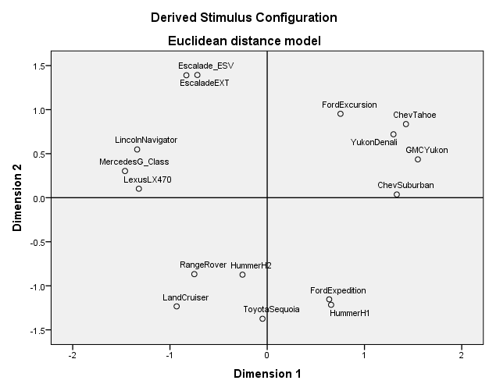
Two-Dimensional Mapping of the Estimated Posterior Correlation Matrix for Segment 1 using ALSCAL in SPSS
Foreign Brands
GM Brands
INTRODUCTION
MODEL DESCRIPTION
APPLICATION RESULT
DISCUSSION

Slide 57
Choice Predictive Validation Performance Comparison between the Proposed Model and Other Benchmark Models
Measures | Two Holdout Brands | Aggregate Logistic Regression | Aggregate Stepwise Logistic Regression | Bayesian Multivariate Probit Regression | Multivarite Probit Mixture model (without Variable Selection) | The Proposed Model
Choice Hit Rate | GMC Yukon Choice Prediction | 57% | 57% | 56% | 57% | 64%*
 | Ford Expedition Choice Prediction | 66% | 66% | 66% | 66% | 70%*
Jaccard Similarity Index | GMC Yukon Choice Prediction | 36% | 35% | 35% | 36% | 50%*
 | Ford Expedition Choice Prediction | 31% | 31% | 32% | 34% | 43%*
INTRODUCTION
MODEL DESCRIPTION
APPLICATION RESULT
DISCUSSION

Slide 58
Possible Managerial Implications Based on Profile Analysis
Managerial Implications: Firms should effectively communicate this segment with family-valued messages through traditional communication channels.
Significantly higher marriage rate (80.7% vs. 68.1%, p<0.03), higher household size (3.31 vs. 3, p<0.07) and less likely to use the Internet (55% vs. 70.6%, p<0.05). More likely to be Caucasian (80% vs. 76.5%, p<0.05).
“Family Oriented” Segment pursing convenience (59%)
Selected Features: “Not Foreign brands”, “Easy for loading & unloading”, “Good looking”, “Family use”
“Economic Value” Segment (41%)
Selected Features: “Value for the money”, “Reasonable price”, “Good looking”
Lower marriage rate, stronger tendency to use Internet and lower average household sizes.
Managerial Implications: firms should focus on a pricing strategy and communicate the economic value of SUV’s using more online communication channels.
Note, “Good looking” feature is selected across both segments.
INTRODUCTION
MODEL DESCRIPTION
APPLICATION RESULT
DISCUSSION
Notes:
Don’t explain too much here. Seg 1 is less satisfied but more potential for long-term profitable customer group. So at the early state of relation ship, National should care this group with selected variables. Done!

Slide 59
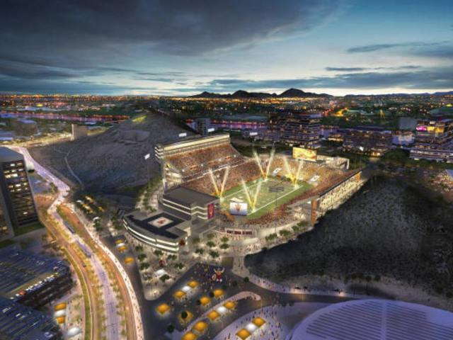

Other Modeling Works: Spatial Models; Text Mining & Sentiment Analysis

Slide 60

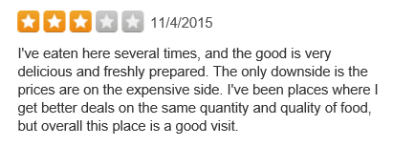



More Visualization of Segmentation searching key drivers:
Inputs: Unstructured Online Review Data
DV:
Star Rating
Key Attribute 1
Segment 1 (30%)
IV: Attribute 1
Key Attribute 3
IV: Attribute 2
IV: Attribute 3
Key Attribute 2
Segment 2 (40%)
Key Attribute 3
Simultaneously Selecting Key Features, Ordinal Probit Analysis and Segmentation
IV: Attribute P
Notes:
Let’s revisit to Bernie’s problem!

Slide 61
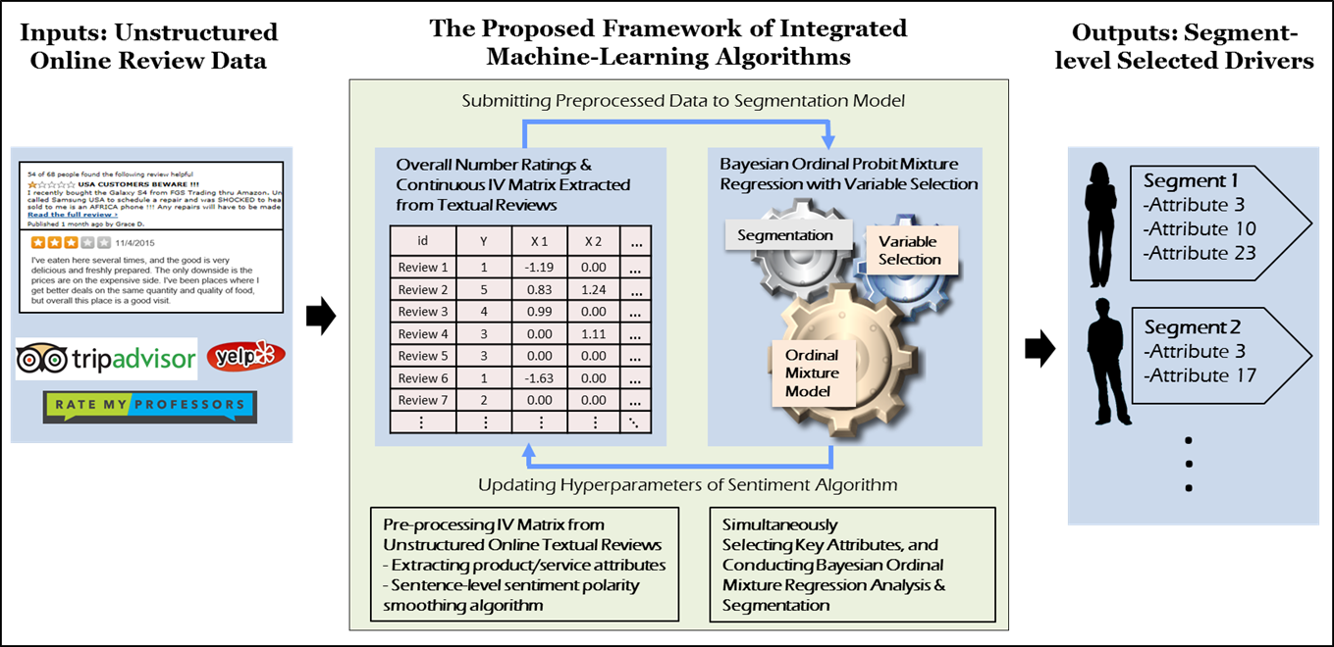
Graphical Illustration of Integrated Machine-Learning Algorithm for Identifying Segment-Level Key Attributes

